Slide 1

Basics of Servers

Slide 2
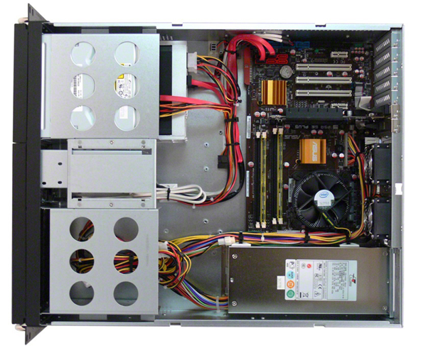
Inside a Server…
CPU, Memory, Hard Drive

Slide 3
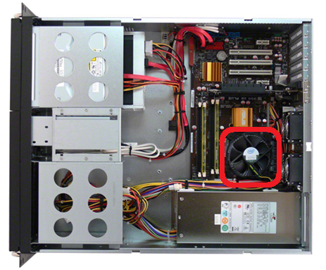
CPU (Central Processing Unit)
CPU is used to process any requests that are created by an Operating System.

Slide 4
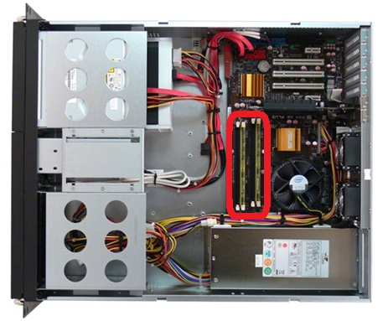
Memory/RAM…
Memory is used to store and maintain processes from an Operating System

Slide 5
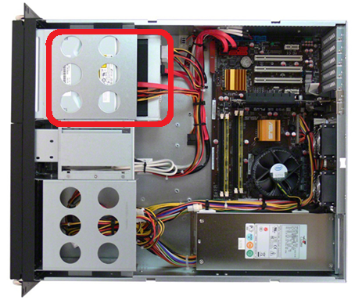
Hard Drive
Hard Drive’s are used to store information (such as an Operating System and Operating System Data).

Slide 6
Memory in detail…
The reason memory cannot be avoided is because Hard Drive’s are slower than Memory.
A typical Memory Bus Bandwidth for Physical Memory is around 48 Gbit/s (6 GB/s) while a standard hard drive speed is around 800-1024 Mbit/s (100 MB/s – 125 MB/S).

Slide 7
DMA.. (Direct Memory Access)
DMA allows hardware such as Disks, Graphics Card, Network Cards, and etc.. to access Memory and CPU independently.
Unlike previous generation’s of hardware where hardware had to access CPU directly first before they can access memory.
DMA assisted in handling concurrent processes at a time, because the processes would queue up in Memory and get processed in CPU and the result is then returned to the Operating System.
Any process from the Operating System, has to come from OS → Hard Drive → Memory → CPU → Memory → OS
Notes:
Inform students about swap (paging Space), DMA is a mother board technology and not OS feature set.

Slide 8
Operating System…
Operating System’s manage Server hardware and define various tasks that are required to be processed by CPU and the output/result is either displayed on screen or stored in memory or hard drive.
There are various different types of Enterprise Operating Systems currently available in the market.
Kernel is the heart of an Operating System and Kernel send’s instructions or code that needs to be compiled or processed

Slide 9
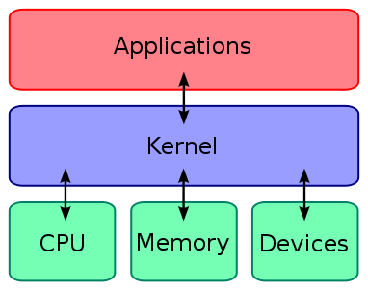
Kernel…
The heart of an Operating System is the kernel, the kernel usually resides in the memory for faster accessibility.
Kernel has all the programming language information that processes and applications need to run.
Kernel acts as a bridge between the software and the hardware layer.

Slide 10
Static vs Dynamic Kernel Part: 1
Static (Monolithic) Dynamic (Microkernels)
Drivers are built in Drivers are linked to
to the kernel the kernel when the hardware is attached
Static Kernel has a very Dynamic Kernel has a Large Memory very small memory foot-print foot-print

Slide 11
Static vs Dynamic Kernel Part: 2
The static kernel has all the drivers built in to the kernel which makes the static kernel memory foot print very large.
Currently there are no static kernels in use to date.
All the modern Operating System’s are packaged with a Micro Kernel which links all the drivers using .DLL (Dynamically Linked Library, Microsoft Windows) or .SO (Shared Object, UNIX/Linux).

Slide 12
Enterprise Operating Systems…
Microsoft Windows Server 200x
Red Hat Enterprise Linux 5.x
Oracle Enterprise Linux 5.x (similar to Red Hat Enterprise Linux 5.x)
VMware ESX
Citrix Xen Server
IBM AIX
HP-UX
Sun Solaris

Slide 13
CPU in detail Part: 1
Every CPU has a Clock Speed, the faster the clock speed the faster the frequency or the number of cycles a CPU can perform in a given time. (for ex: 2 GHZ). The speed of a CPU cycle determines how fast a process is processed.
CPU Cache is used by the CPU to store frequently accessed data or processes rather than in the memory because it reduces access time between CPU and Memory.

Slide 14
CPU in detail Part: 2
Hyper threading: Hyper threading allows a processor to run two thread’s at a time.
Hyper threading works by duplicating certain section’s of a processor
A Hyper threaded processor can appear as two processor’s rather than just one in operating systems.
So a dual-core hyper threaded processor will appear in an operating system as 4 processors.
Notes:
Every process/task by an OS can have several thread’s but with out core’s a CPU cannot process more than one or two (w/ hyperthreading) threads at a time.

Slide 15
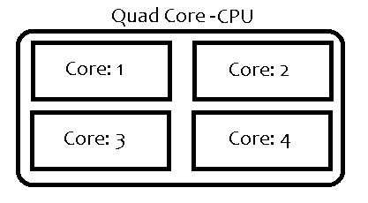
CPU in detail Part: 3
CPU Cores: In today’s modern CPU’s you will find a lot of the CPU’s are being marketed as Dual-Core, Quad-Core, etc… What a core means is that a CPU can be divided in to multiple smaller CPU’s so that multiple processes can be executed a time. With out core’s a CPU can process only one process (or thread) at a time.

Slide 16

CPU in detail Part: 4

Slide 17
CPU in detail Part: 5
Multiple Processors/CPU
A Server can have multiple processors, this is all based how the motherboard was designed and who designed the motherboard. Below are various types of processors for Servers.
Intel Xeon
AMD Opteron
Power PC by IBM
PA-RISC by HP
SPARC by SUN (or Oracle)

Slide 18
CPU in detail Part: 6
32 bit vs 64 bit vs 128 bit.
Most of the modern computers are now 32 bit based computers, the reason for the 32 bit limitation is because the motherboard cannot transfer more than 32 bits of information at a time from Memory to the CPU and this limitation is due to the Bus Channel in the motherboard.
Most of the modern servers and newer computers are now 64 bit based and super computers are now 128 bit based.
The wider the bus bandwidth, the more information can be sent at a time to be processed.

Slide 19
Networking
Prasad Potluri
11/24/2010
Version-1

Slide 20
What is a Network ?
A network allows exchange of information or data across a computer network.
A data network is a group of computers connected to one another by communication paths, as well as the standards that allow communication.
A network can connect to other networks, allowing virtually worldwide communication between two endpoints

Slide 21
Types of Networks…
Modern Network’s always use TCP/IP and TCP/IP is divided in to LAN’s and WAN’s.
LAN: Local Area Network is a small geographical area such as a Corporate Office Network. LAN’s can also be considered as an intranet.
WAN: Wide Area Network is extremely large geographical area such as the entire world or a country. WAN’s can also be considered as an internet.

Slide 22
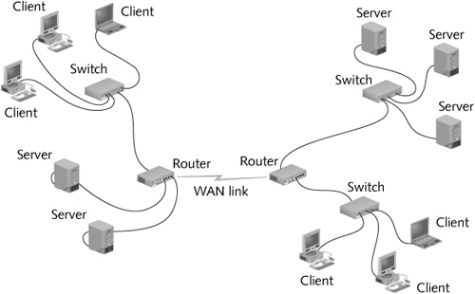
A Sample LAN-WAN Relationship…

Slide 23
TCP/IP (Transmission Control Protocol/Internet Protocol) Part: 1
TCP/IP allows modern corporate network communication between two ends or two network cards or two network devices any where in the world.
TCP/IP communicates using data bits or packets. The biggest advantage of using TCP/IP is there is minimal or no packet-loss due to its retry interval (considering there are no other network issues such as a router or switch outage).

Slide 24
TCP/IP (Transmission Control Protocol/Internet Protocol) Part: 2
To know more about TCP/IP please study the OSI Model at http://www.tech-faq.com/osi-model.html
To keep things simple TCP/IP is nothing but a protocol to send information across multiple devices.
To make things easier the transmission control in the abbreviation of TCP means that packets are transferred in a controlled fashion across multiple devices, and it doesn’t matter if the network is either a WAN or a LAN.

Slide 25
IP Addresses… or IP v4 Part: 1
Network devices in the world such as Network Cards (wireless cards) all have a unique MAC/Physical address. (for ex: 00-25-D3-CE-6C-94). MAC address are hexadecimal digits.
IP addresses are used to a define a 4-byte address to a network device or to a MAC address. All the IP address are defined in a 4 dot’s decimal notation (for ex: 10.10.0.10).
So when two devices are communicating with each other using IP address, they are actually communicating with their MAC address. Once the first packet reaches the receiver from the sender it communicates back with it’s MAC address and vice-versa.

Slide 26
IP Addresses… or IP v4 Part: 2
The max number of IP address are limited to 4,294,967,296 (2^32) because IP v4 is 32-bit or 4-bytes.
The 32 bit limitation has nothing to do with the CPU limitation of 32 bit, at the time when they designed IP v4 no one expected there would be use for more than 4.3 billion IP addresses.
The 2 to the power of 32 comes in because IP addresses are further translated in to Binary which is 2 to the power of X.

Slide 27
Public IP’s vs Private IP’s
Address range | Number of addresses
10.0.0.0–10.255.255.255 | 16777216
172.16.0.0–172.31.255.255 | 1048576
192.168.0.0–192.168.255.255 | 65536
IP addresses in the above tables are considered Private IP’s.
Any IP address that is not in the above range is automatically
considered a Public IP address.

Slide 28
Private or Reserved IP’s in detail…
IP range | Description
0.0.0.0/8 | Current network (only valid as source address)
10.0.0.0/8 | Private network
127.0.0.1/8 | Loopback
169.254.0.0/16 | Link-Local
172.16.0.0/12 | Private network
192.0.0.0/24 | Reserved (IANA)
192.0.2.0/24 | TEST-NET-1, Documentation and example code
192.88.99.0/24 | IPv6 to IPv4 relay
192.168.0.0/16 | Private network
198.18.0.0/15 | Network benchmark tests
198.51.100.0/24 | TEST-NET-2, Documentation and examples
203.0.113.0/24 | TEST-NET-3, Documentation and examples
224.0.0.0/4 | Multicasts (former Class D network)
240.0.0.0/4 | Reserved (former Class E network)
255.255.255.255 | Broadcast
Notes:
Loopback IP address: The IP address 127.0.0.1 is used as the loopback address. This means that it is used by the host computer to send a message back to itself.

Slide 29
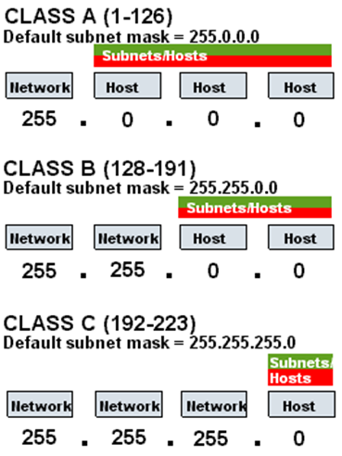
Subnet Masks and Classes…

Slide 30
Static vs Dynamic IP Address
Static IP’s are IP address which are manually configured by a user or administrator on a Server or Workstation.
Dynamic IP address are automatically generated by a service called DHCP. A DHCP server in your private network assigns a IP address.
In most corporation’s if not all Servers are assigned a Static IP address and Workstations are assigned a Dynamic IP address.

Slide 31
Address Resolution…
Hosts on the Internet are usually known not by IP addresses, but by names (e.g., www.google.com, www.yahoo.com)
When you type in www.google.com in your browser, the address is then translated to a IP address with the help of a DNS (Domain Name System).
The easiest example of a DNS is like your phone book. Every number in the phone book has a name.

Slide 32
DNS Server advantages…
The advantage of DNS server is that it makes it nearly impossible to remember IP address for each website that you visit.
For example a daily website that every visits such as www.google.com is translated to 72.14.204.103. So you can either enter www.google.com or 72.14.204.103 every time you want to visit Google.

Slide 33
Various Type of Network Services and Protocols Part: 1
DHCP (Dynamic Host Configuration Protocol) Server: DHCP Server’s are used for automatic network configuration (IP address, Gateway, DNS) on a client (Workstations or Laptops). It also provides a central database for keeping track of computers that have been connected to the network.
DNS (Domain Name System): DNS Server provides name resolution. The quickest example of DNS Server is a phone-book.

Slide 34
Various Type of Network Services and Protocols Part: 2
Gateway/Router: A gateway is a final point where data switches from one network to another, a Router is nothing but a service which routes traffic from one network to another. For ex: When you access www.google.com , your Linksys gateway/router is the final point before your workstation hits Google’s servers. Also when you access www.google.com , your Linksys gateway/router is also routing traffic from LAN → WAN → LAN.
Print Server: A print server manages a Print Queue to various printers in the network, A print server also controls the priority (for ex: first come first print basis) to printers.

Slide 35
Various Type of Network Services and Protocols Part: 3
File Server: A File Server is a common location where you would save things like Documents, System Images or Software.
FTP Server: A FTP Server is a service that can be enabled on a server which a client or user can use to upload files in to that server.
Web Server: A Web Server is a service that runs on a server which can be used to host your own websites.
E-Mail Server (Exchange Server): An Email Service that run’s on a Server which maintains all your E-Mail and also has additional functionality like creating mail accounts and controlling spam and various other options.

Slide 36
Various Type of Network Services and Protocols Part: 4
Active Directory or LDAP Server: An LDAP (Lightweight Directory Access Protocol) Server is a Centralized or a Common Service that run’s on a Server which maintains all the User Information such as User Accounts for Users to login to their workstations. So when a user log’s in to a Corporate Network Workstation, the workstation authenticates the user against a LDAP Server for his credentials.
VPN Server: A VPN (Virtual Private Network) Server allows users from an Outside Network (WAN) connect to a Inside Network (LAN). VPN allows administrator’s perform day to day tasks while working from home or remotely.

Slide 37
VLANs

Slide 38
Objectives
Explain the role of VLANs in a converged network.
Explain the role of trunking VLANs in a converged network.
Configure VLANs on the switches in a converged network topology.
Troubleshoot the common software or hardware misconfigurations associated with VLANs on switches in a converged network topology.

Slide 39
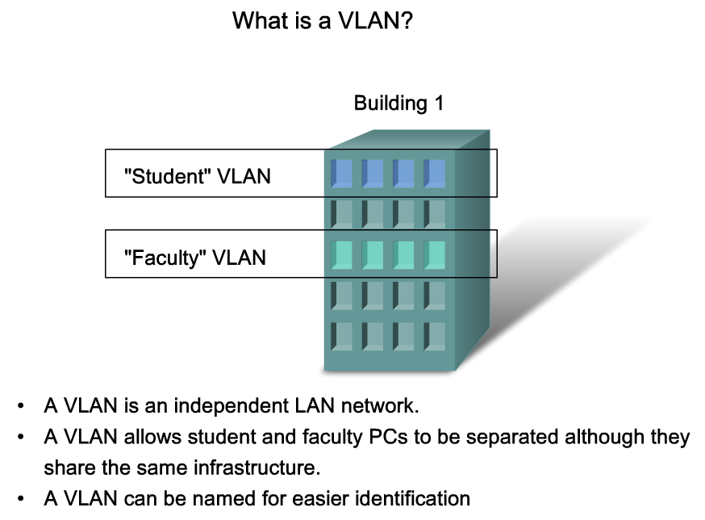
Explain the Role of VLANs in a Converged Network
Explain the role of VLANs in a converged network
Notes:
Graphic 3.1.1.2

Slide 40
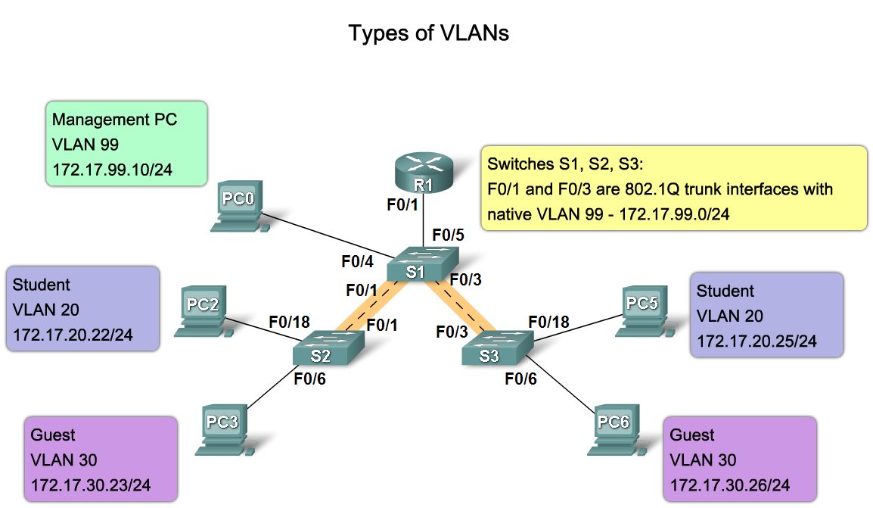
Explain the Role of VLANs in a Converged Network
Describe the different types VLANs
Notes:
Graphics 3.1.2.1 & 3.1.2.2

Slide 41
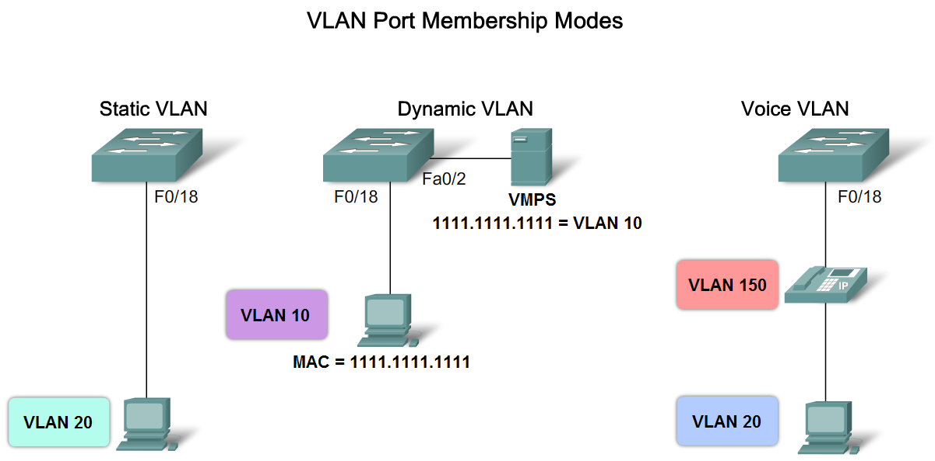
Explain the Role of VLANs in a Converged Network
Describe the VLAN port membership modes
Notes:
Graphic 3.1.3.1

Slide 42
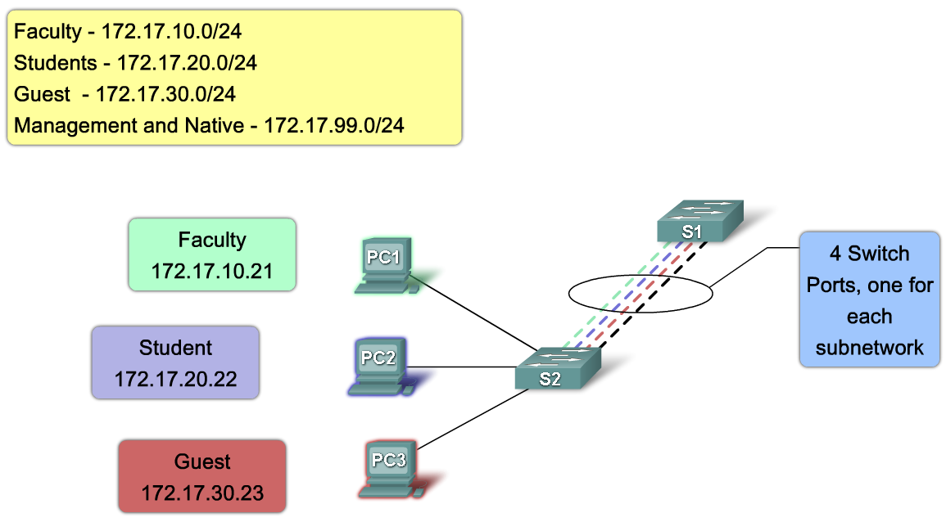
Explain the Role of Trunking VLANs in a Converged Network
Explain the role of a trunk when using multiple VLANs in a converged network
Notes:
The objective listed above doesn’t make much sense to me. I’m not sure what is wanted….I think that the objective should read something like the following “ explain the role of a trunk when using multiple VLANs in a converged network.”
Use graphic 3.2.1.2

Slide 43
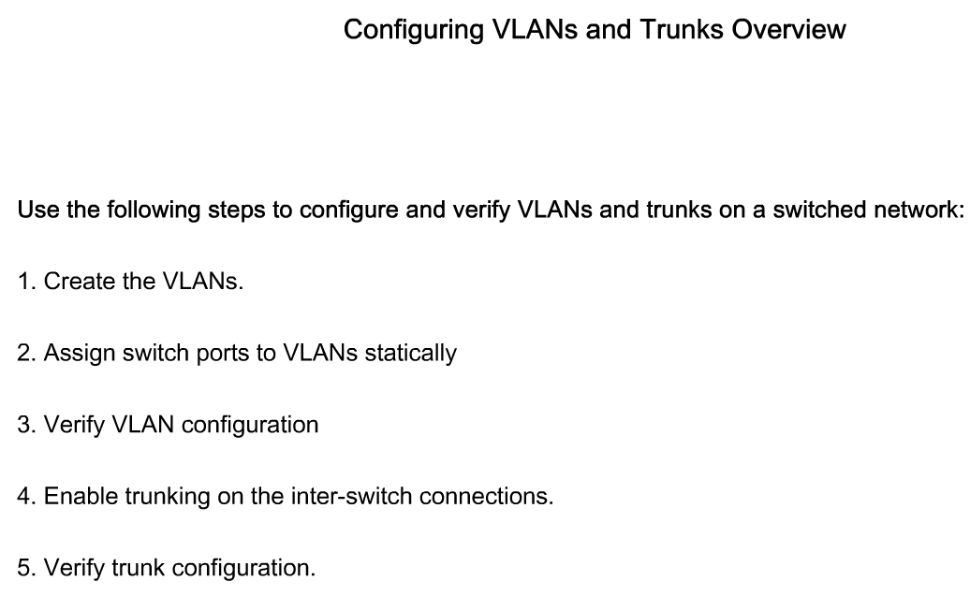
Configure VLANs on the Switches in a Converged Network Topology
Describe the steps to configure trunks and VLANs
Notes:
Graphic 3.3.1.1

Slide 44
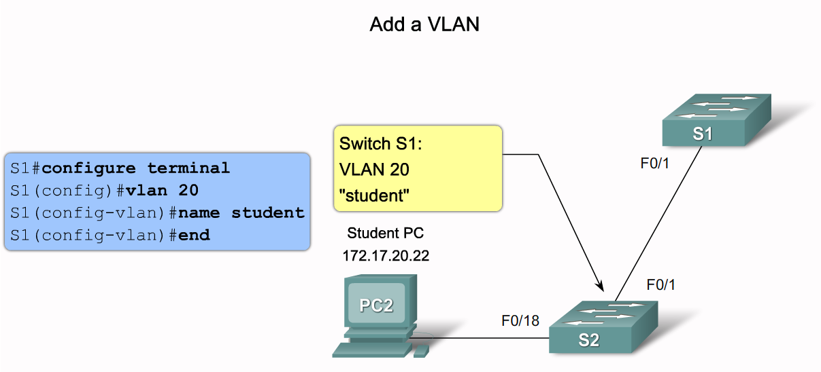
Configure VLANs on the Switches in a Converged Network Topology
Describe the Cisco IOS commands used to create a VLAN on a Cisco Catalyst switch
Notes:
Graphic 3.3.2.1 ( if space is an issue use the example)
Graphic 3.3.2.2 (use example graphic)

Slide 45
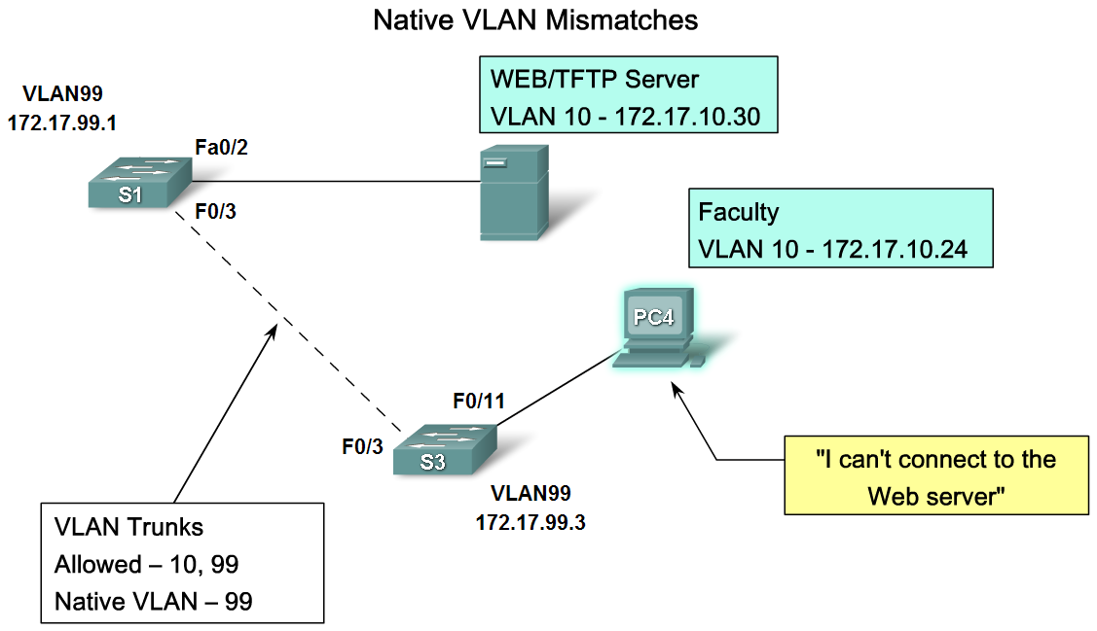
Troubleshoot Common Software or Hardware Misconfigurations Associated with VLANs
Describe the common problems with VLANs and trunks
Notes:
Graphic 3.4.1.2
Graphic 3.4.1.3

Slide 46
Summary
VLANS
Allows an administrator to logically group devices that act as their own network
Are used to segment broadcast domains
Some benefits of VLANs include Cost reduction, security, higher performance, better management

Slide 47
Summary
Types of Traffic on a VLAN include
Data
Voice
Network protocol
Network management
Communication between different VLANs requires the use of
Routers

Slide 48
Blades
Prasad Potluri
11/24/2010
Version-1

Slide 49
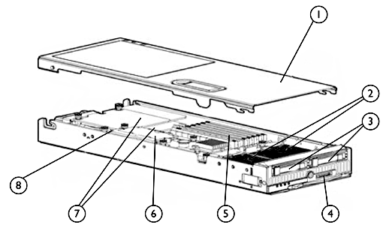
Inside a HP BL460c Blade…
1. Access Panel | 5. Eight Fully Buffered Memory DIMMS
2. 2-Way Quad Core Intel Xeon Processors/CPU | 6. HP Smart Array E200i Controller
3. Small form factor (SFF) hot-plug drive bays | 7. Mezzanine Slot-1: Emulex LPe1105-HP Mezzanine Slot-2: Empty
4. Local I/O Connector | 8. Internal USB Connector

Slide 50
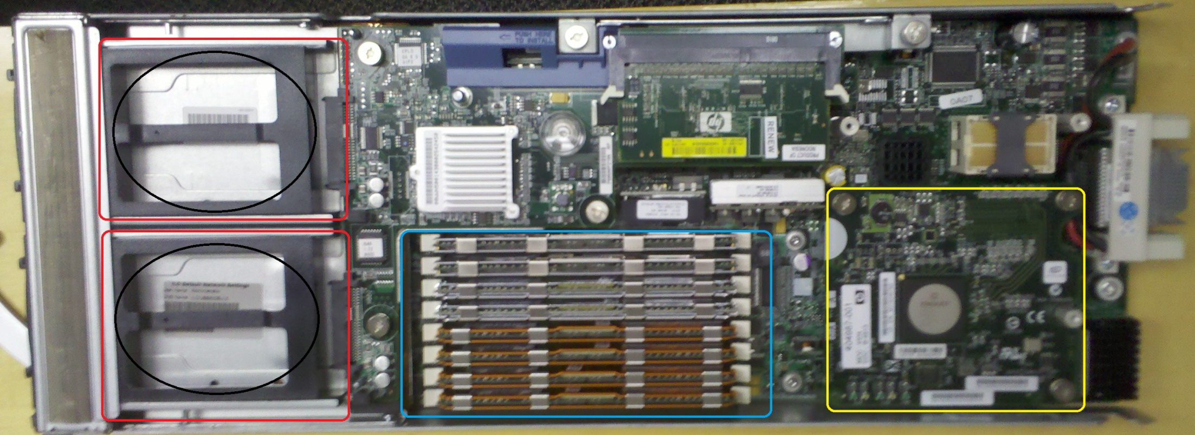
Digital Terrain HP BL460c Blade…
2-Way Quad Core Intel Xeon Processors/CPU
8 x 1GB Fully Buffered ECC DIMM
Emulex LPe1105-HP Mezzanine Fibre-Channel HBA HBA (Host Bus Adapter) or simply known as “Card”.
Dual Empty Small Form Factor HDD bays. (Boot from SAN)

Slide 51
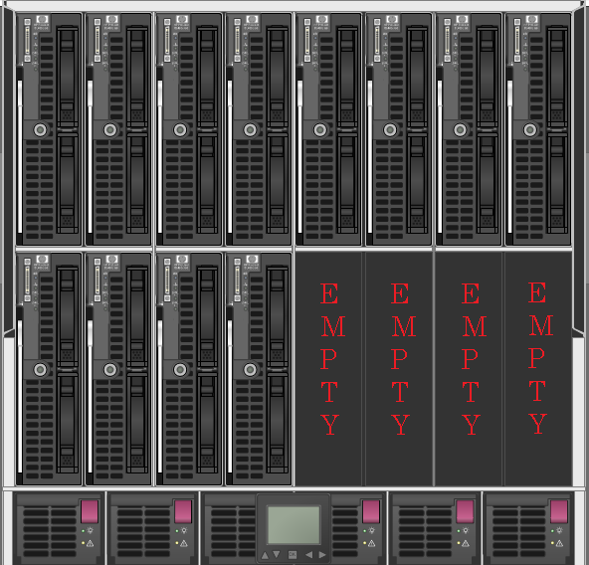
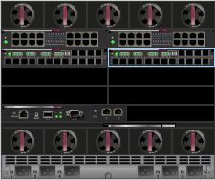
HP C7000 Enclosure…

Slide 52
SAN (Storage Area Network)
Prasad Potluri
11/24/2010
Version-1

Slide 53
What is SAN ?
Storage Area Network (SAN) is a collection of computers and storage devices, connected over a high-speed optical network and dedicated to the task of storing and protecting data.
SAN uses the SCSI (Small Computer Storage Interconnect) and FC (Fibre Channel) protocols to move data over a network and store it directly to disk drives in block format. SCSI and FC protocols from SAN are relative to what TCP/IP is to LAN and WAN.
Typically high-speed SAN network usually consists of fiber-optic cables and switches that use light waves to transmit data with a connection protocol known as Fibre Channel or SCSI.

Slide 54
SAN in detail…
Before SAN was ever implemented in to corporate networks, administrator’s had to directly connect a disk array to the server.
After SAN was implemented you had Storage Array connected to switches, and you had Servers/blades connected to switches which could access the Storage Array simultaneously.
SAN is very similar to LAN because you have the same concept of Devices such as switches for multiple network devices and unlike LAN, SAN was designed only for data access and storage.

Slide 55
Benefits of SAN Part: 1
Removes the distance limits of SCSI-connected disks: The maximum length of a SCSI bus is around 25 meters. Fibre Channel SANs allow you to connect your disks to your servers over much greater distances. Current Fibre Channel Technology has a limit of 6.2 miles.
Greater performance: Current Fibre Channel SANs allow connection to disks at hundreds of megabytes per second; the near future will see speeds in multiple gigabytes to terabytes per second.
Increased disk utilization: SANs enable more than one server to access the same physical disk, which lets you allocate the free space on those disks more effectively.

Slide 56
Benefits of SAN Part: 2
Higher availability to storage by use of multiple access paths: A SAN allows for multiple physical connections to disks from a single or multiple servers.
Deferred disk procurement: That's business-speak for not having to buy disks as often as you used to before getting a SAN. Because you can use disk space more effectively, no space goes to waste.
Reduced data center rack/floor space: Because you don't need to buy big servers with room for lots of disks, you can buy fewer, smaller servers — an arrangement that takes up less room.

Slide 57
Benefits of SAN Part: 3
New disaster-recovery capabilities: This is a major benefit. SAN devices can mirror the data on the disks to another location. This thorough backup capability can make your data safe if a disaster occurs.
Online recovery: By using online mirrors of your data in a SAN device, or new continuous data protection solutions, you can instantly recover your data if it becomes lost, damaged, or corrupted.
Better staff utilization: SANs enable fewer people to manage much more data.
Reduction of management costs as a percentage of storage costs: Because you need fewer people, your management costs go down.

Slide 58
Benefits of SAN Part: 4
Improved overall availability: This is another big one. SAN storage is much more reliable than internal, server-based disk storage. Things break a lot less often.
Reduction of servers: You won't need as many file servers with a SAN. And because SANs are so fast, even your existing servers run faster when connected to the SAN. You get more out of your current servers and don't need to buy new ones as often.
Improved network performance and fewer network upgrades: You can back up all your data over the SAN (which is dedicated to that purpose) rather than over the LAN (which has other duties). Since you use less bandwidth on the LAN, you can get more out of it.

Slide 59
Benefits of SAN Part: 5
Increased input/output (I/O) performance and bulk data movement: Yup, SANs are fast. They move data much faster than do internal drives or devices attached to the LAN. In high-performance computing environments, for example, IB (Infiniband) storage-network technology can move a single data stream at multiple gigabytes per second.
Reduced/eliminated backup windows: A backup window is the time it takes to back up all your data. When you do your backups over the SAN instead of over the LAN, you can do them at any time, day or night. If you use CDP (Continuous Data Protection) solutions over the SAN, you can pretty much eliminate backup as a separate process (it just happens all the time).
Protected critical data: SAN storage devices use advanced technology to ensure that your critical data remains safe and available.

Slide 60
Benefits of SAN Part: 6
Nondisruptive scalability: Sounds impressive, doesn't it' It means you can add storage to a storage network at any time without affecting the devices currently using the network.
Easier development and testing of applications: By using SAN-based mirror copies of production data, you can easily use actual production data to test new applications while the original application stays online.
Support for server clusters: Server clustering is a method of making two individual servers look like one and guard each other's back. If one of them has a heart attack, the other one takes over automatically to keep the applications running. Clusters require access to a shared disk drive; a SAN makes this possible.

Slide 61
Benefits of SAN Part: 7
Storage on demand: Because SAN disks are available to any server in the storage network, free storage space can be allocated on demand to any server that needs it, any time. Storage virtualization can simplify storage provisioning across storage arrays from multiple vendors.

Slide 62
How SAN devices communicate…
Using English as a metaphor, think of a typical protocol conversation like this:
HBA in the server: "Hey! How are you' I'm in this server, and I'm trying to find a disk drive to store this data. Who are you'"
Switch: "Hi. I'm a Fibre Channel switch. I see that you can speak Fibre Channel. Let's talk using the new version 2 dialect, okay'"
HBA in the server: "Okay. Look, do you know of any good disk drives I can use to store the data?"
Switch: "Sure, according to your address, I've been authorized to give you access to a drive on my Port 3. Would you like to speak with her? Remember, SCSI drives speak a different language. Do you speak SCSI?"
HBA in the server: "Nope, but the server's application does! Thanks. I'll have him send you all the data using the SCSI protocol. Can you forward this to the disk?"
Switch: "Done deal. Hey, SCSI drive on Port 3, here's a message for you!"
At this point, the session is established; the switch now passes SCSI messages through to the disk drive. The drive acknowledges the messages and does what the server tells it to do.

Slide 63
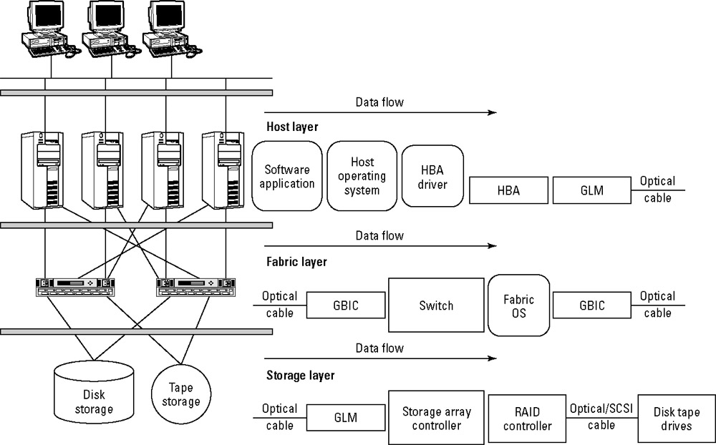
A Sample SAN…

Slide 64
SAN Players…
EMC Clariion and Symmetrix (DMX)
NetApp FAS solutions
HP EVA
IBM System Storage
3par
Compellent
Xiotech
Dell EqualLogic
Apple Xserve RAID

Slide 65
RAID (Redundant Array of Independent Disks)
RAID is a technique for storing the same data on multiple hard disks to increase read/write performance and fault tolerance. In a properly configured RAID storage system, the loss of any single disk will not interfere with users' ability to access the data stored on the failed disk.
RAID has become a standard but transparent feature in both enterprise-class and consumer-class storage products.
Various RAID Types
RAID – 0 | RAID – 5
RAID – 1 | RAID – 6
RAID – 1+0 | RAID – 0+1

Slide 66
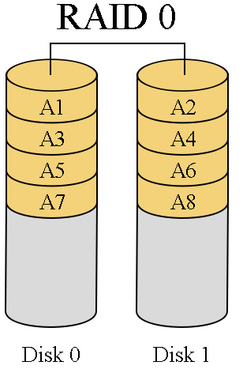
RAID 0
RAID 0 (Striping) requires a minimum of two disks, an array with its disks configured in RAID 0 mode will have its data written sequentially and concurrently.
In RAID 0 if a disk fail’s all the
data is lost.

Slide 67
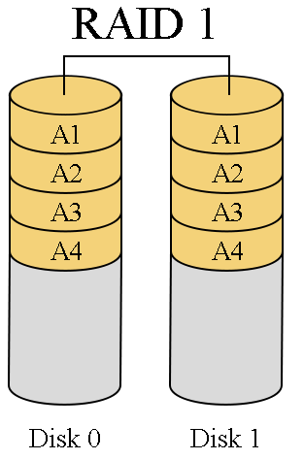
RAID 1
RAID 1 (Mirroring) also requires minimum of two disks, an array with its disks configured in RAID 1 mode will have the data written identically.
In RAID 1 if a disk fail’s the data
will not be lost because of
mirroring.

Slide 68
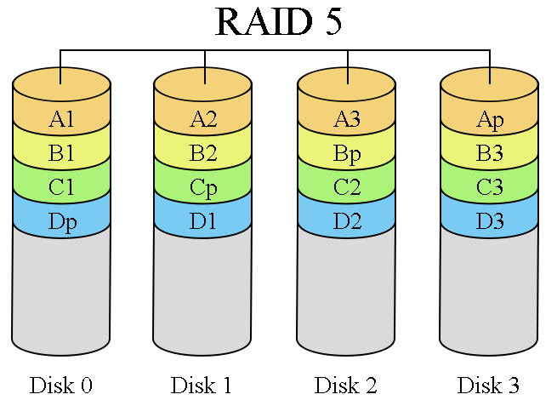
RAID 5
Click on the below link to study the XOR algorithm.
http://en.wikipedia.org/wiki/XOR_swap_algorithm
RAID 5 (Striping + Parity) requires a minimum of three disks, an array with its disks configured in RAID 5 mode will have its data written concurrently but all the disks will have a parity sector.
In RAID 5 if more
than one disk fails
all the data is lost.

Slide 69
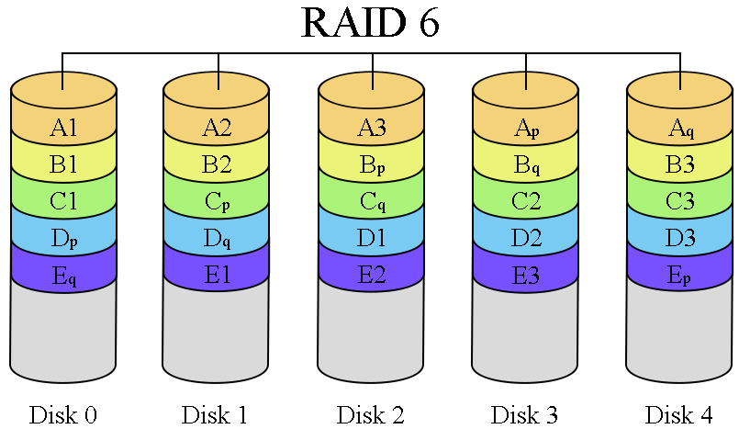
RAID 6
RAID 6 (Striping + Double Parity) requires a minimum of four disks, an array with its disks configured in RAID 6 mode will have its data written concurrently but all the disks will have a double parity sector.
In RAID 6 if more
than two disks
are lost all the
data is lost.

Slide 70
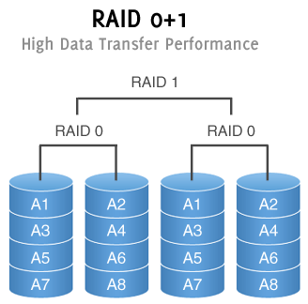
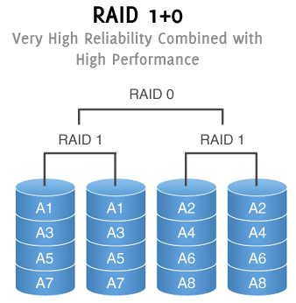
RAID 0+1 and RAID 1+0
Notes:
The biggest advantage raid 10 has over raid 0+1 is that if a single drive fails in raid 0+1 it would pretty much make the raid 1 in raid 0+1 in to raid 0.

Slide 71
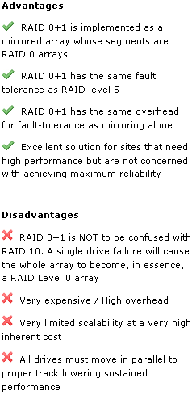
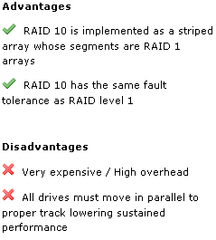
RAID 0+1 RAID 1+0

Slide 72
RAID Acronyms…
Striping: Disks configured in Striped Mode will have the data written across the disks.
Mirroring: Disks configured with Mirroring Mode will have the data mirrored or maintain an exact replica in another or opposite disk.
Parity: Parity Mode works by performing a logical operation on the data that is being stored on the disks. The result from the logical operation is written to a sector on the disks that are in the array.
To read more about parity please refer to Information about Parity.doc
Notes:
http://www.pcguide.com/ref/hdd/perf/raid/concepts/genParity-c.html

Slide 73
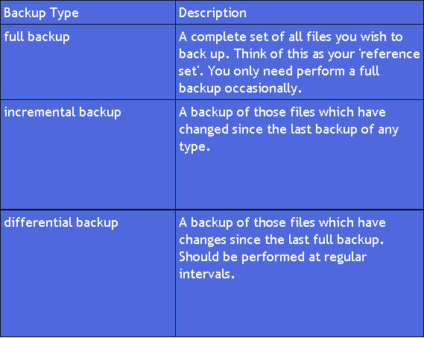
Backups

Slide 74
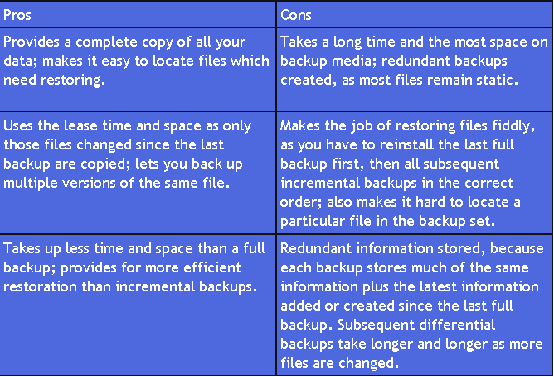
Backups.. Part 2

